Slide 1
Acute Toxicity to Drugs & Drug Induced Liver Toxicity
Supportive care in “ABCs” – Airway, Breathing, Circulation
Gather history of exposure
Evaluate clinical presentation: The Toxidrome
Interpret laboratory data
Proceed with appropriate care
Immediate First Aid and Decontamination
Poison by respiratory/inhaled
Poison of the skin
Poison of the eye
Poison swallowed … 2-4 oz water immediately unless unable to swallow/convulsion/unconscious – IPECAC only under advice of Poison Control Center, ED, or physician

Slide 2
Ipecac
NOT recommended for routine home decontamination
- Generally used within 1 hr of ingestion
- Induces emesis within 15-30 min
- 1-6 episodes lasting up to 1 hr
- Direct stimulation of CNS chemoreceptor trigger zone or direct irritation of GI
- Dosing: prepare dose with 6-8 oz water, juice or soda
6 mos
1 yr
12 yrs
5-10 ml
15 ml
15-30 ml
Contraindications:
Children < 6 months
Patients without a gag-reflex
Ingestion of caustics, corrosives, bleach, ammonia, or sharp objects
Patients who are
Lethargic
Comatose
Convulsing
Or expected to become unresponsive within 30 minutes

Slide 3
Gastric Lavage
Used in more extraordinary situations
- Generally used within 1 hr of ingestion
- Wash out gastric contents with fluids (tap water or NS)
- Tubing size: 12 mm for adults, 8 mm for children – Tablet size should be small
Contraindications
Ingestion of corrosives, hydrocarbons
Seizures
Unprotected airways
Complications
Aspiration pneumonia
Laryngospasm
Esophageal and stomach injury
Hypothermia
Fluid/electrolyte imbalance
Unable to use large enough tube in children < 12

Slide 4
Activated Charcoal
Increase in popularity
- Ideally used within first few hrs of ingestion
- Adsorption prevents absorption
- Ineffective for Fe, Pb, Li, simple alcohols, corrosives
- Dosing: repeat doses q 2-4 hrs
1 yr
2 yrs
1 g/kg
25-50 g
50-100 g
Most useful for drugs that have:
Low VD: < 11/kg)
Low plasma binding
Biliary or gastric secretion
Active circulating metabolites

Slide 5
Whole Bowel Irrigation
Used for drugs that are not well-adsorbed by activated charcoal or SR/EC drugs
- Generally reserved when ingestion is several hrs after arrival to ED
- Polyethylene glycol electrolyte solution - Osmotically balanced sol admin 4-12 hrs causing rectal discharge or drug
- Dosing: 0.25 – 0.5 L/hr (CHILD) 1 – 2 L/hr (ADULTS)
Contraindications
Bowel perforations, osbstruction, GI bleeding

Slide 6
Use of antidote never replaces good supportive care
Examples:
Glucagon--β-blocker overdose/ CCB overdose
Atropine—anticholinesterases
Digoxin Immune Fab (Digibind)
Dimercaprol; penicillamine: Heavy metal poisons
Calcium EDTA; succimer: Lead
Flumazenil: Benzodiazepines
Naloxone: Opioids
Oxygen: carbon monoxide
Fomepizole or Ethanol: methanol/ethylene glycol
(see list for others)

Slide 7
Antidotes
Use of antidote never replaces good supportive care
ACETAMINOPHEN
N-acetylcysteine (NAC)
FDA approved Acetadote brand IV
IRON
Deferoxamine
Chelation therapy
BETA BLOCKERS
Glucagon
LEAD
Dimercaprol or BAL (British Anti-Lewisite) - IM
CaNa₂EDTA – IM, IV or SC
Succimer (Chemet®) - PO
CYANIDE
Amyl nitrite/Na nitrite/Na thiosulfate & oxygen
Hydroxocobalamine

Slide 8
Biotransformation in Liver
First Pass Metabolism
Phase I
(Toxification)
Phase II
(Detoxification)
Drug
Active Metabolite
Conjugate
Cytochrome P450
GSH transferases
Glucuronidases
Sulfotransferases
Polar/water soluble
Oxidation or Demethylation
Conjugation with:
Glutathione
Glucuronic acid
Sufate
Hepatic Injury
Covalent binding to hepatocellular proteins
Creation of oxidative stress
Stimulation of an immune attack
GSH: Glutathione - body's master antioxidant

Slide 9
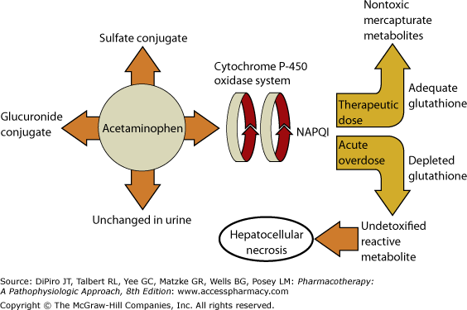
Most common cause for:
- Overdose
- Acute hepatic in the US
- Liver transplant in the UK
Second most common cause for liver transplant in the US
ACETAMINOPHEN

Slide 10
Acetaminophen Toxicity
Toxic Dose:
Child: 140 mg/kg
Adult: 4 g/d
Hepatotoxicity: 3-4 g/d in 1 yr or 5-8 g/d in 2 mos
Alcohol-Acetaminophen syndrome
24 hrs
48 hrs
96 hrs
Manifestations
Right upper quadrant pain
Acute renal failure
Jaundice, coagulopathy
Hepatic encephalopathy
Anorexia, N/V
Change in lab values
↑ international normalized ratio
↑ liver function test (TBIL, ALT, AST)
Antidote--N-acetylcysteine (NAC)

Slide 11
General Tx
Elimination by:
Gastric lavage if < 1 hr after ingestion
Activated charcoal if < 4 hrs after ingestion
Antidote with NAC based on Rumack-Matthew nomogram
Antidote--N-acetylcysteine (NAC)
Mechanism:
Substituting for glutathione as sulhydryl donor
Dose:
140 mg/kg PO diluted in juice or soda … then … 70 mg/kg q 4 hrs x 17 doses
FDA Approved: ACETADOTE brand IV
Loading dose: 150 mg/kg over 15 min
Maintenance dose: 50 mg/kg q 4 hrs … then … 100 mg/kg over 16 hrs

Slide 12
Salicylates
Aspirin: ASA
Trilisate: Choline Mg trisalicylate
Arthopan: Choline salicylate
Doan’s: Mg salicylate
Phases and Manifestations in Salicylate Poisoning
Phase I
Respiratory ALKALOSIS
because of its direct stimulatory effects on respiratory centers in the medulla.
Phase II
Anion gap Metabolic ACIDOSIS HCO3 < 15 mEq/L
This occurs because salicylate interrupts aerobic respiration by uncoupling oxidative phosphorylation and interfering with the krebs cycle. This results in the anaerobic production of lactate.
Others: Hypoglycemia, Fever, Dehydration, Electrolyte imbalance (hypo-Na & K)

Slide 13
Salicylates
Mechanism of Salicylate Toxicity
↑ sensitivity of respiratory centers to ∆ in O2 & CO2
↑ rate & depth of respiration
Respiratory ALKOLOSIS
↑ bicarbonate renal excretion
Metabolic ACIDOSIS

Slide 14
Salicylates
Uncoupling of oxidative phosphorylation
↓ aerobic respiration
↑anaerobic respiration
↑Pyruvate/ lactate
Metabolic Acidosis
↑rate of metabolism
Hyperthermia
↑demand for peripheral glucose
↑metabolism of fat/protein
↑Ketone bodies (Ketoacidosis) &
CNS deterioration

Slide 15
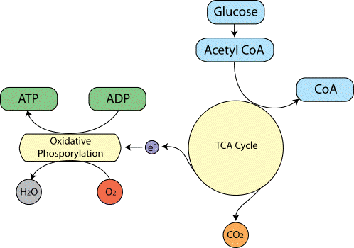
Salicylates
Utilization Pathway of Glucose Blocked
Excess of Ketone Bodies:
Acetoacetate
Β-Hydroxybutyrate
Uncoupling by Salicylates

Slide 16
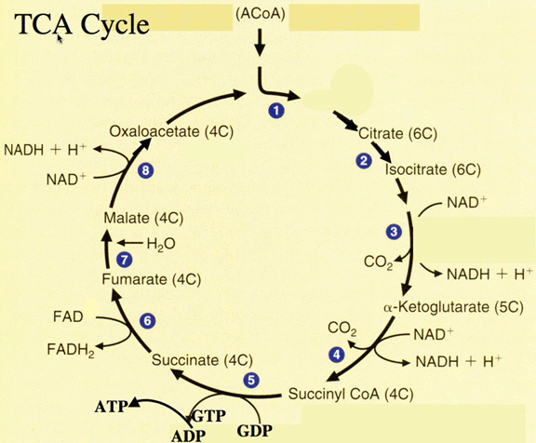
Excess
To electron transport & oxidative phosphorylation
X
Oxidative phosphorylation

Slide 17
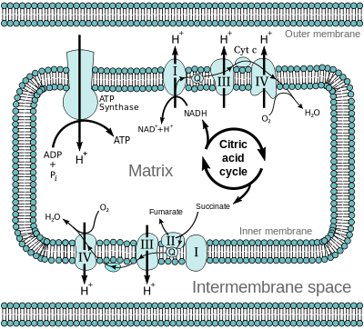
Diffusion of H+ back inside of mitochondria generate ATP by OXIDATIVE PHOSPHORYLATION
Uncoupling by Salicylates

Slide 18
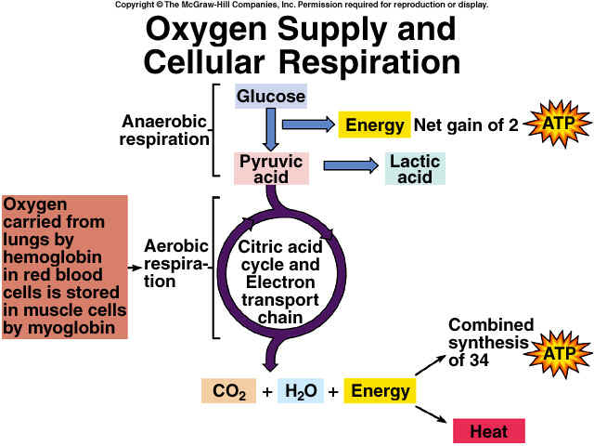
↑Anaerobic
↑ Pyruvic / lactic
Blocked

Slide 19
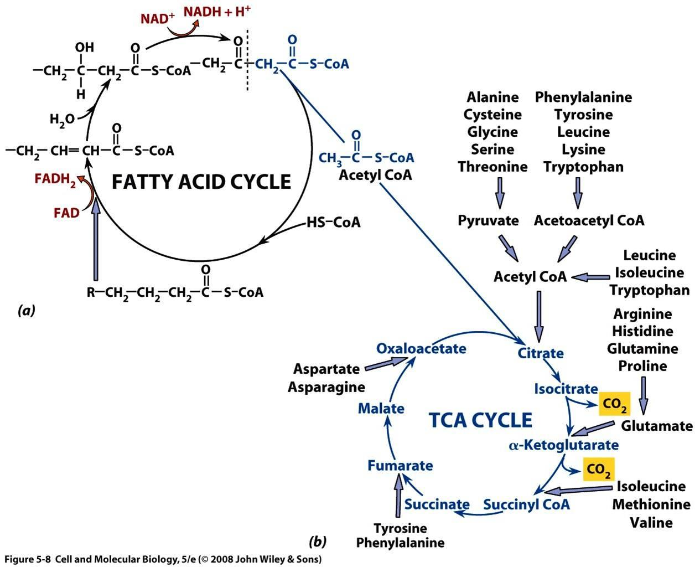
Salicylates
Utilization Pathway of Fatty Acid
Converted to Ketone Bodies

Slide 20
Salicylates
Volume depletion
insensible water loss, vomiting, osmotic diuresis
electrolyte disturbances
decrease renal function
Inhibit hepatic synthesis of clotting factors, as well as ASA blocking platelet aggregation

Slide 21
Salicylates
Risk Assessment
150 mg/kg
300 mg/kg
500 mg/kg
Mild to none
Mild to moderate
Severe
Potentially Lethal
Asymptomatic
Hyperpnoea
Agitation
Convulsion
Coma
Convulsion
Coma
CV collapse
Chronic intoxication: > 100 mg/kg/d for > 2-3 days
Serial serum levels of salicylate should be obtained due to delayed or prolonged absorption

Slide 22
Salicylates
TREATMENT
Elimination by:
Activated charcoal
Hemodialysis for severe poisoning
- Alkalization of urine regardless of blood pH with IV bicarbonate to enhance renal elimination
Supportive by:
Tx electrolyte abnormalities
Seizures with BZDs
Fluids, O2, dextrose, vit K
Cooling blankets for hyperthermia

Slide 23
Tricyclic Antidepressants
Toxicokinetics
- Rapidly and completely absorbed from the GI tract
- Cmax 2-8 hours post ingestion
- Half-lives: 24-76 hr (prolonged in overdose)
- Undergo enterohepatic recirculation
- Large Vd 10-20 L/kg; highly protein bound > 95%
Clinical Manifestations
- Cardiac arrhythmias with intraventricular conduction delayed or bundle-branch block
Hypotension due to blocking of vascular α adrenergic
Anticholinergic
Cardiotoxicity
Sinus tachycardia
Hypotension & pulmonary edema

Slide 24
Tricyclic Antidepressants
Risk Assessment
TCA blood levels generally correlate with severity
< 300 ng/ml “therapeutic”
> 1000 ng/ml severe
Treatment
Elimination by gastric lavage & charcoal
Na bicarbonate … the most effective for TCA cardiovascular toxicity
Arrhythmias: Lidocaine
Hypotension: fluid first … then … dopamine & other pressors
Seizure: BDZ
- Ipecac contraindicated due to possibility of rapid neurologic deterioration and high risk of seizure
- HD no role

Slide 25
IRON
Usually multivitamins
Mechanism of Toxicity:
GI irritation … hemorrhage, perforation, Fluid & electrolytes imbalances
Mitochondrial poison … hepatotoxicity
Metabolic acidosis
CV effects
SHOCK
6 hrs
24 hrs
36 hrs
2 - 6 wks
Stage 1
Stage 2
Stage 3
Stage 4
Persistent vomiting
Scarring & gastric strictures/permanent dysfunction
Liver necrosis
CNS: coma, seizure
Hepatotoxicity
CV shock
↓ Sx
Improved clinical
N/V/D
Ab pain
Blood in stool

Slide 26
IRON
Usually multivitamins
Risk Assessment
Dose of elemental Fe
20 mg/kg
60 mg/kg
Mild
Moderate
Severe / Lethal
Mild GI Sx
Systemic toxicity but not serious
Systemic toxicity / Emergency
Lab Assessments
Serum Fe Levels:
< 350 mcg/dL … not severe
> 500 mcg/dl … high
Glucose & WBC ↑
Radio-opacities

Slide 27
IRON
Usually multivitamins
Treatment
Elimination by:
Ipecac if recent ingestion < 2 hrs or 10-60 mg/kg of elemental Fe
Gastric lavage or whole bowel irrigation
Antidote with chelation therapy - Deferoxamine
- Serum level > 500 mcg/dl
Deferoxamine Dosing (IM or IV)
Goal: serum Fe level < 350 mcg/dl in 12 hrs & resolution of Sx
Adults: 1 gram IM … then 500 mg IM q 4 hrs x doses
Max: 6 g/d
Reserve IV route for CV shock … 15 mg/kg/hr
Max: 6 g/d

Slide 28
CYANIDE Toxicity
Most common cause: NITROPRUSSIDE
Free cyanide: 44%
Released into bloodstream producing hydrogen cyanide (toxic)
Mechanism of Cyanide Toxicity
Cyanide blocks mitochondrial cytochrome oxidase
Prevents electron-transport & oxygen utilization & oxidative metabolism
Ingested cyanide salt can react with HCl to form hydrocyanic acid - lethal
Elimination of Cyanide
Hepatic elimination rate = cyanide production during nitroprusside infusion of ~ 2 mcg/kg/min
Renal elimination by thiocyanate … accumulation of thiocyanate with renal impairment … neurotoxic syndrome, ↓ thyroid function
Cyanide Blood Levels
0.02 mg/dL
0.1 mg/dL
0.25 mg/dL
0.3 mg/dL
No Sx
Flushing Tachycardia
Obtundation
Coma
Death

Slide 29
Cyanide blocks cytochrome oxidase & prevents electron transport & oxygen utilization
NADH/H+ from Kreb cycle transfers electrons to electron-carrier protein & pumps H+ out … combined with O2 to form H2O
Diffusion of H+ back inside of mitochondria generate ATP by OXIDATIVE PHOSPHORYLATION

Slide 30
Toxicity Manifestations
Within seconds:
Burning mouth, throat, agitation, syncope, N/V, headache, diaphoresis, dyspnea, tachycardia, HTN … convulsion, CV shock, death
Bitter almond odor on breath
Treatment of Cyanide Toxicity
Antidote:
- Amyl nitrite … Na Nitrite … Na thiosulfate … and oxygen (reverse the binding of cyanide to cytochrome oxidase)
- HYDROXOCOBALAMIN
Amyl nitrite
Hemoglobin
Met-HB
Cyano-Met-HB
Thiocyanate
(non toxic)
Na nitrite
Cyanide
Na Thiosulfate
Hydroxocobalamin has a higher binding affinity for cyanide than cytochrome oxidase and is able to exert its antidotal effect by binding to cyanide to form cyanocobalamin (vitamin B12). The body then excretes cyanocobalamin renally.

Slide 31
Beta Blocker Overdose
Beta Receptors:
BETA 1: 1⁰ in heart muscle … activation causes ↑ HR & contractility
BETA 2: 1⁰ in bronchial/peripheral smooth muscle … activation causes vaso-/bronchodilation
BETA 3: in adipose tissue & heart … activation causes catecholamine-induced thermogenesis & ↓ cardiac contractility
Competitive antagonism at B1 receptor
Decreased cellular levels of cAMP
Decreased myocardial contractility
Decreased automaticity of pacemaker cells
Decreased conductivity through AV node
Nonselective blockade
Bronchoconstriction, impaired gluconeogenesis, decreased insulin release
Drug Factors:
Lipophilicity … cross BBB into CNS … seizure, delirium
Sustained-release products
Drugs stabilizing membrane activity … inihibit fast Na channel … prolonged QRS interval … dysrhythmias – ACEBUTOLOL (most toxic BB in overdose), Propranolol, Betaxolol
Sotalol combines Beta blockade and class III arrhythmias … blocking delayed K channel … QT prolongation

Slide 32
Beta-Blocker Overdose vs Other Drugs
Cholinergic Agents:
Digoxin:
Ca Channel Blockers:
Clonidine:
http://wikem.org/wiki/Beta-Blocker_Toxicity

Slide 33
Treatment of β-blockers Overdose
Toxidrome:
Bradycardia, Hypotension
Brochospasm
Hypoglycemia
Mental status changes (delirium, seizure, coma)
Treatment:
ABC
Atropine for emergent bradycardia
Fluids for hypotension
Arrhythmias (Na bicarbonate for prolonged QRM complex, Mg for torsade, Advanced CV Life Support)
Additional:
Glucagon
IV Ca salts – Ca gluconate (peripheral), Ca chloride (central)
Vasopressors (not for monotherapy … b/c of too high dose & potential arrhythmias)
High dose of insulin & glucose infusion
Lipid emulsion therapy (for lipophilic drugs: verapamil, TCA, buvipicaine, chlopromazine, some BBs)

Slide 34
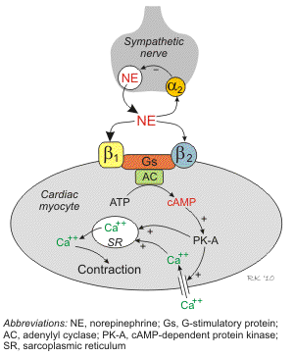
β-blockers & Calcium Channel Blockers
Role of Glucagon
↑ Adenylate cyclase then cAMP
↑ reentry of Ca
↑ chronotropic for bradycardia
↑ inotropic for hypotension
First line antidote for Beta-Blocker Overdose

Slide 35
Lead Poisoning
Absorption:
Major routes: GI & Respiratory
Distribution:
Initially in soft tissue (kidneys, liver) … then in bone, teeth, hair
Circulating lead in erythrocytes
T1/2: 1-2 mos (blood), up to 20 yrs (bones)
Effects of lead toxicity:
Hematologic – inhibits heme synthesis
Hypochromic, microcytic anemia – misdiagnosed with iron deficiency
GI
Lead colic & constipation
Neuromuscular
Lead palsy (wrist & foot drop)
CNS
Loss of motor skills & speech development, hyperkinetic/aggressive behavior disorders (misdiagnosed with ADHD)
Lead encephalopathy (clumsiness, vertigo, ataxia, HA, insomnia, irritability, tonic-clonic convulsions, coma)
Renal
Acute tubular necrosis
Other
Skin (ashen color to face & lips)
Gum (lead line)
Premature aging syndrome (stooped posture, poor muscle tone, emaciation)

Slide 36
Diagnosis
Blood test:
Lead level test
Erythrocyte protoporphyrin (EP) & urinary δ-ALA levels are not sensitive if lead level < 25 mcg/dL
Abdominal X-ray for lead particles/objects
Na₂EDTA is a chelator for Ca
Treatment
Lead-rebound phenomena needs to be retreated
Chelators:
- Dimercaprol or BAL (British Anti-Lewisite) – Peanut Oil - IM
- Used only in combo with other chelators
- 2 BAL molecules combine with 1 lead atom forming a stable complex … excreted in urine & feces via bile
- Contraindicated in pts with G6PD-deficiency
- Potential nephrotoxin – urine should be at pH alkaline
- CaNa₂EDTA – IM, IV or SC
- ↑ urinary excretion of lead by 20-50 fold
- Mono-TX when lead level < 70 (in combo with BAL if > 70)
- Potential nephrotoxin
- Hepatocellular damage but reversible
- Penicillamine – not approved by FDA
- Succimer (Chemet®) – Only PO chelator approved by FDA
- Cannot be used as an out-patient therapy

Slide 37
Other Drug-Induced Hepatotoxicity
Fatty-Liver / Cirrhosis-Like Rx:
Prototype: AMIODARONE
Cholestatic Rx:
Estrogens, co-trimoxazole, rifampin, nafcillin, chlorpromazine, erythromycin
Blockage of bile flow due to drugs – liver function normal
Hepatic Veno-Occlusive Disease:
Similar to cholestatic Rx but more severe and serious
Allergic Hepatitis:
Phenytoin, co-trimoxazole
Systemic allergic Rx, fever, rash, lymphadenopathy, eosinophilia
Can result in hepatic necrosis &/or cholestasis
Idiosyncratic Hepatotoxic RX:
Allopurinol, ASA (Reye’s syndrome), sulfonamides, quinidine, HMG-co-reductase inhibitors, valproic acid, INH
Usually non-dose related & non-immune system related
Mixed forms with hepatic dysfunction

Slide 38
SUMMARY of Treatments
Salicylates:
Acetaminophen:
Elimination by:
Activated charcoal
Hemodialysis for severe poisoning
- Alkalization of urine regardless of blood pH with IV bicarbonate to enhance renal elimination
Elimination by:
Gastric lavage if < 1 hr after ingestion
Activated charcoal if < 4 hrs after ingestion
Antidote with NAC
Supportive by:
Tx electrolyte abnormalities
Seizures with BZDs
Fluids, O2, dextrose, vit K
Cooling blankets for hyperthermia
Tricyclic Antidepressants
Elimination:
- Gastric lavage, charcoal
Na bicarbonate … the most effective for TCA cardiovascular toxicity
Arrhythmias: Lidocaine
Hypotension: fluid first … then … dopamine & other pressors
Seizure: BDZ
Iron
Elimination by:
Ipecac if recent ingestion < 2 hrs or 10-60 mg/kg of elemental Fe
Gastric lavage or whole bowel irrigation
Antidote
Deferoxamine

Slide 39
SUMMARY of Treatments
Cyanide
Antidote:
- Amyl nitrite … Na Nitrite … Na thiosulfate … and oxygen (reverse the binding of cyanide to cytochrome oxidase)
- HYDROXOCOBALAMIN
Lead
Dimercaprol or BAL (British Anti-Lewisite) – Peanut Oil - IM
CaNa₂EDTA – IM, IV or SC
Succimer (Chemet®) – Only PO chelator approved by FDA
Beta Blockers
Atropine for emergent bradycardia
Fluids for hypotension
Arrhythmias (Na bicarbonate, Mg, Advanced CV Life Support)
Additional:
Glucagon
IV Ca salts – Ca gluconate (peripheral), Ca chloride (central)
Vasopressors (not for monotherapy … b/c of too high dose & potential arrhythmias)
High dose of insulin & glucose infusion

